Slide 1

The History of SQL
The Language of Modern Data
From Konstantin Pandilovski 6227

Slide 2

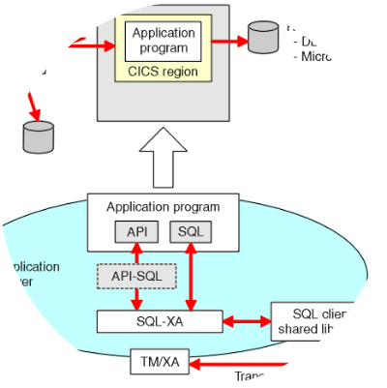
The Foundation: 1970
Dr. Edgar F. Codd
In 1970, IBM researcher E.F. Codd published "A Relational Model of Data for Large Shared Data Banks.“
He proposed moving away from hierarchical and network models toward Relational Algebra—organizing data into simple tables (relations).

Slide 3
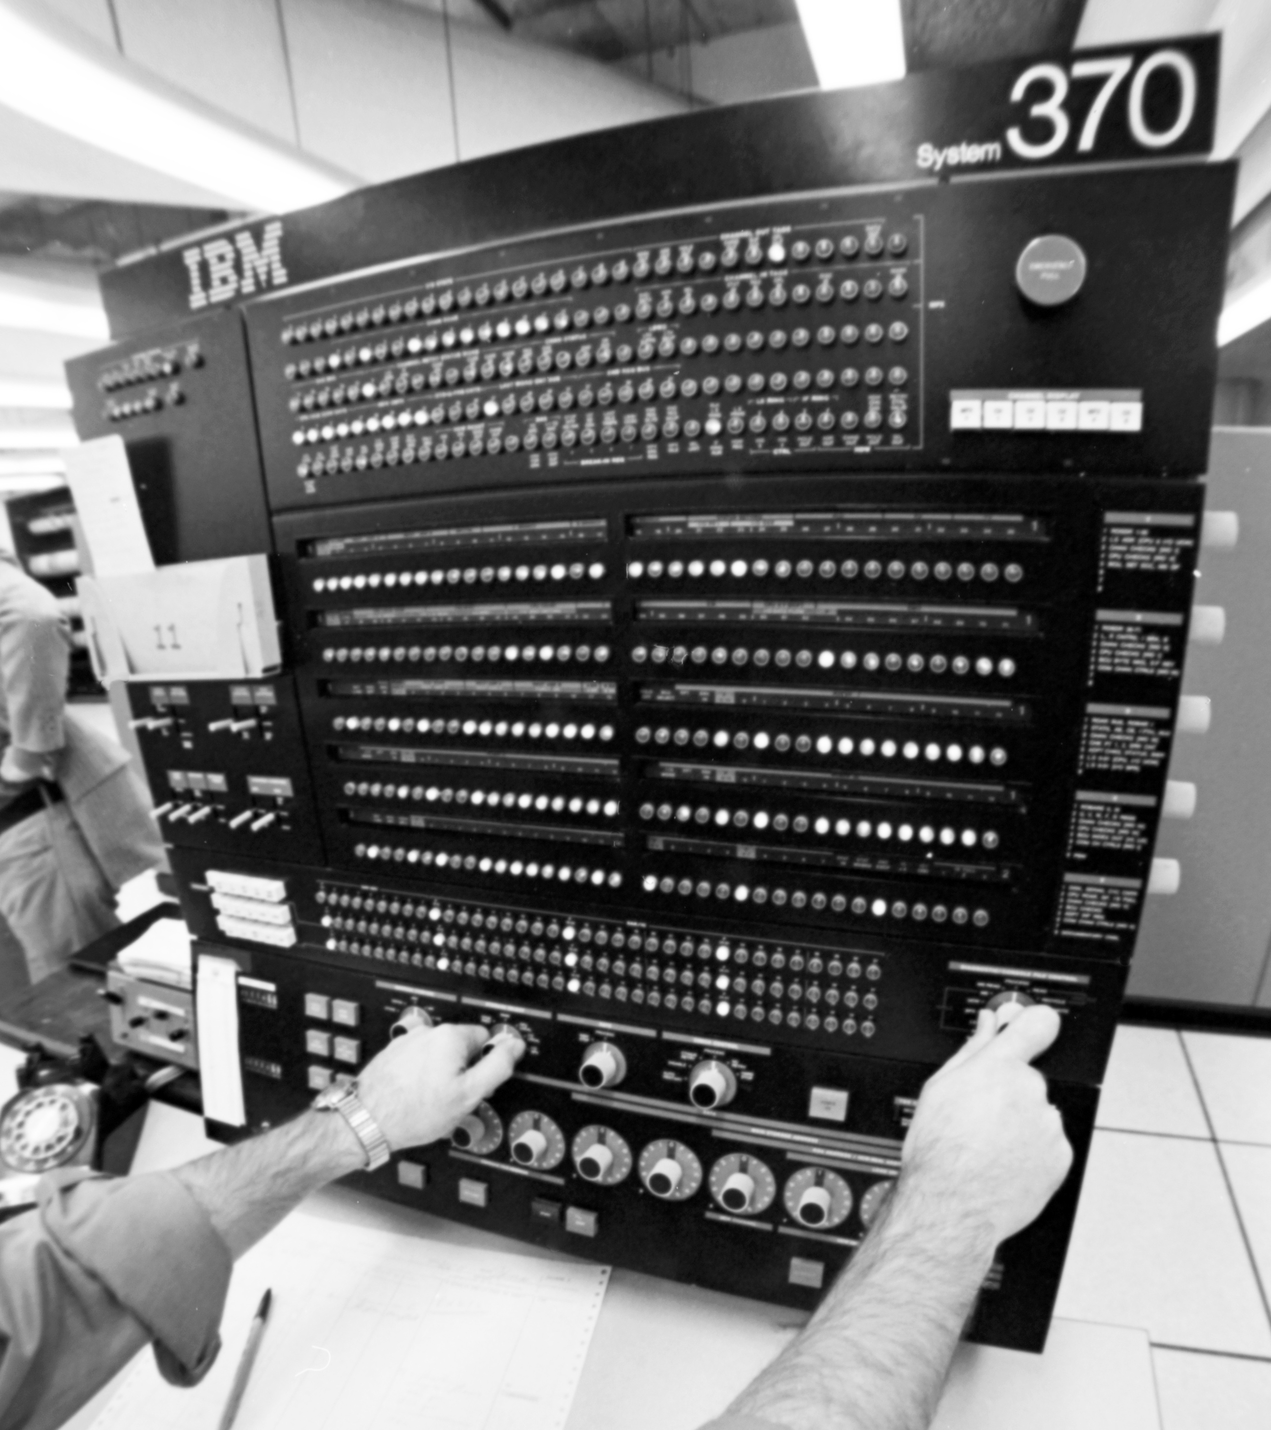
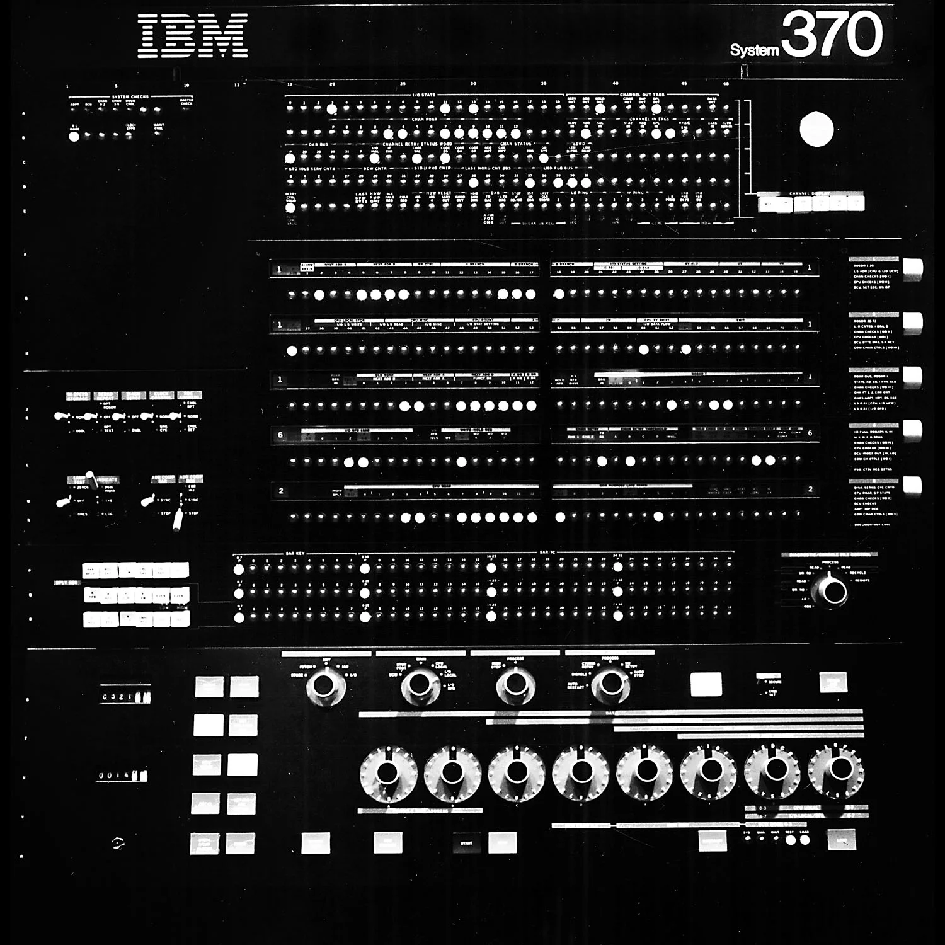
The Implementation: IBM System R
Inventing the Language
Donald D. Chamberlin and Raymond F. Boyce developed the first iteration of SQL to interact with IBM's System R project.
Their goal was to create a language that was closer to English than mathematical notation, making it accessible to non-specialists.

Slide 4






From SEQUEL to SQL
SEQUEL
The Trademark
SQL
Originally called Structured English Query Language. The name was intended as a "sequel" to a previous attempt called SQUARE.
IBM was forced to drop the vowels because "SEQUEL" was a trademark of the UK-based Hawker Siddeley aircraft company.
It became Structured Query Language. Despite the spelling, many still use the original pronunciation "sequel."

Slide 5
Becoming the Global Standard
ANSI adopts SQL-86 standard
SQL-92 (The dominant baseline)
1986
1992
1979
1987
Oracle V2 released (1st commercial SQL)
ISO formalization

Slide 6

The Evolution of Syntax
Year | Standard | Key Additions
1999 | SQL:1999 | Triggers, Recursive Queries, Object-oriented features
2003 | SQL:2003 | Window Functions, XML support, Auto-generated values
2016 | SQL:2016 | JSON support, Polymorphic table functions
2023 | SQL:2023 | Graph Query support (SQL/PGQ), multidimensional arrays

Slide 7
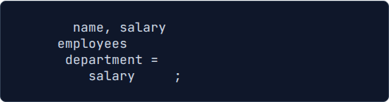
Why It Works: Declarative Nature
The "What" and "How"
SQL is declarative. You tell the database what data you want, not how to physically retrieve it.
The Query Optimizer handles the complexity of scanning indexes or joining tables, allowing SQL to remain relevant as hardware evolves.
SELECT
FROM
WHERE
'Engineering'
ORDER BY
DESC

Slide 8

Adapting to Big Data
The 21st Century
Despite the "NoSQL" movement of the late 2000s, SQL adapted. It now powers Distributed SQL databases (CockroachDB, Spanner) and massive Data Warehouses (Snowflake, BigQuery).
Native support for semi-structured data like JSON allows SQL to handle modern web application data effortlessly.

Slide 9
Thank You
Questions on the History of SQL?

